Slide 1

DOES ECONOMIC FREEDOM MEAN HAPPINESS?
Doruk Balcı Mert Bakcacı Cem İz Ece Taşan Fatih Yavuz

Slide 2
OUTLINE
Introduction
Data Description
Data Cleaning & Restructring
Linear Regression
Classification Methods
Comparison&Conclusion

Slide 3
INTRODUCTION
From ancient philosophers to modern scholars, mankind have been seeking ways to define the term and trying to find means to achieve happiness on personal and universal levels.
With availability of mass data and the improvements in data interpretation techniques like ML in the recent decades, we are more confident about finding a more provable and less controversial answers to questions regarding happiness.
Our Project aims to understand this relationship and predict a country’s happiness index by using the components of the economic freedom index.

Slide 4
DATA DESCRIPTION
Economic Freedom Index: Uses five main variables
Size of Government: Higher government spending, taxation, size of the government-controlled enterprises
Legal System and Property Rights: Protection of persons and their rightfully acquired property.
Sound Money: Inflation erodes the value of rightfully earned wages and savings.
Freedom to Trade Internationally: Freedom to Exchange goods and services in its broadest sense
Regulation: Limits economic activity
World Happiness Index is calculated by using:
GDP Per Capita
Family
Life Expectancy
Freedom
Generousity
Trust
Government Corruption

Slide 5
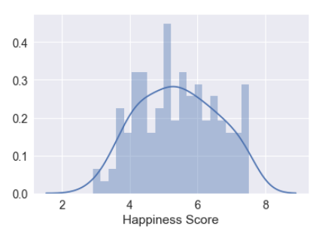
DATA CLEANING AND EDA
Merging: Our common link was the country variables, so we merged both of them. While merging them we used the 2016 data, as it was the most recent year.
Since our happiness score was not a binary variable, we could use it as the dependent variable for our linear regression. However we also wanted to use classification methods in our study as well. So we first look at the distribution graph of the happiness score variable.
The peak is at 5, and the mean score of the Happiness Score is 5.41. In order to create our binary variable for happiness, we created a new variable “Happy”. If a country’s happiness score is above 5, it’s value is 1. Else, it’s zero.

Slide 6
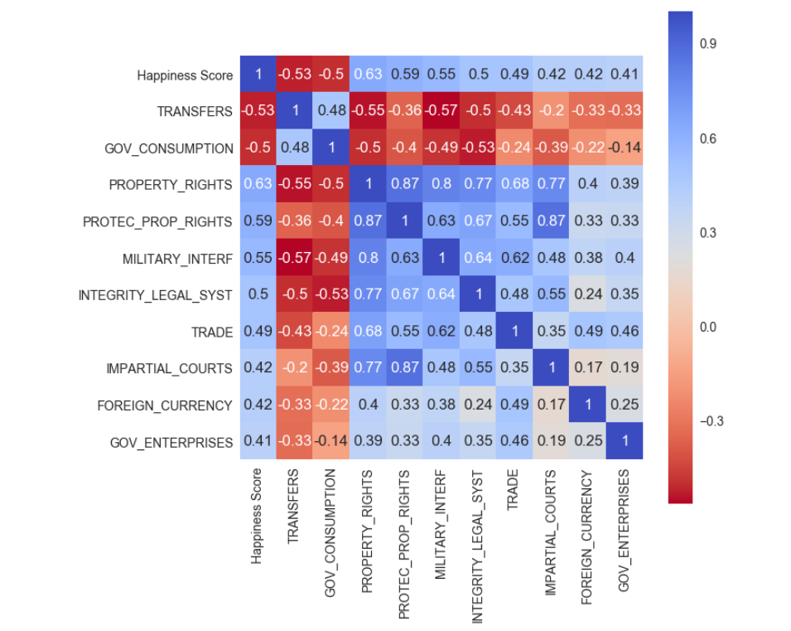
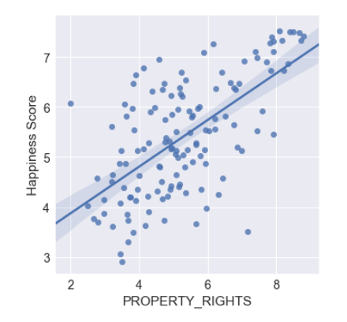
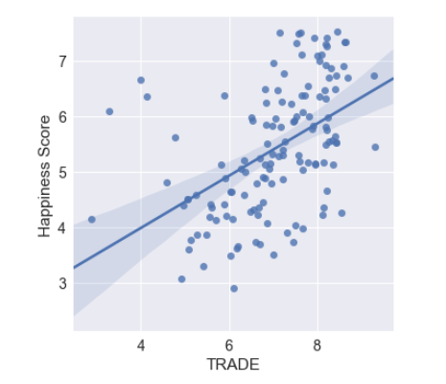
Data Cleaning and EDA contd.

Slide 7
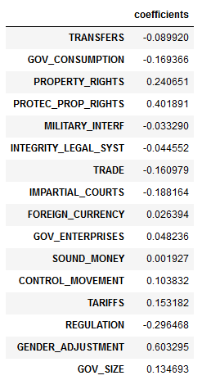

LINEAR REGRESSION
We used all the variables that had a correlation more than 0.3 with the Happiness Score.
This raises the question multicollinearity, since some of the variables have more than 0.7 correlation. However this is a machine learning problem. Predictive power is more important.

Slide 8
Attitude Towards Classification Problem
Two main problems: Feature Selection & (Hyper)Parameter Tuning
Use grid-search like structure for feature selection(add one more variable each iteration, variables are sorted from highest correlation to lowest.) For every feature set, optimize the (hyper)parameters for every feature set in the inner loop.
Logistic Regression
Tuned parameter : «C» regularization parameter.
Optimal feature set and regularization parameter can be seen below:

Slide 9
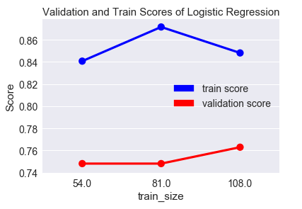
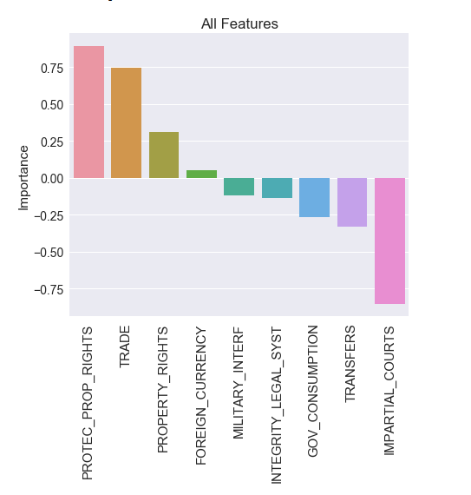
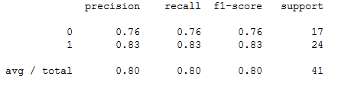
Classification Methods: Logistic Regression Cont.
The average accuracy score on 5-Fold test set is 0.808 and accuracy score on test set is: 0.805..

Slide 10
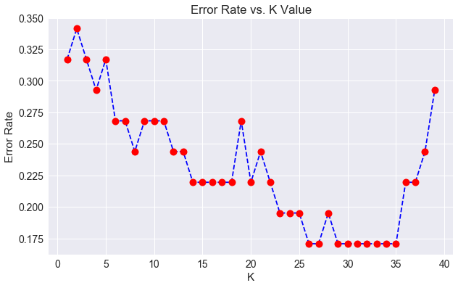
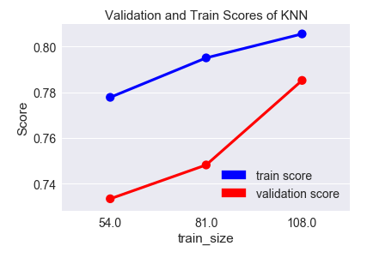
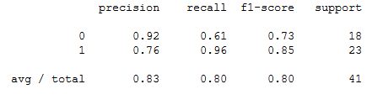
Classification Methods: KNN
Optimized Parameter : K
The test with the highest accuracy score (0.805) uses transfers, property rights and the protection of property rights as variables. We constructed a KNN model with the above mentioned variables and K values from 1 to 40.

Slide 11
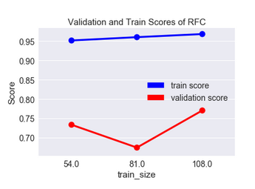
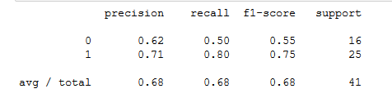
Classification Methods: Random Forest Classifier
Optimized Parameter:Number of Estimators
Average accuracy on K-fold test set : 0.74
Validation and train scores are inconsistent.
Precision, recall and f-1 score is considerably lower with respect to Logistic Regression and KNN.

Slide 12
Comparison&Conclusion
We used Linear Regression to see the relationship between Happiness Score and Economic Freedom Variables.
We have used three methods classification methods: Logistic Regression, K-Nearest Neighbours and Random Forest.
Our main point of comparison was their average accuracy score on KFold test and their validation scores to test their soundness. The lowest accuracy belonging to the Random Forest method, the winner of this comparison was the Logistic Regression Model with an average K-fold accuracy score 0.808 and a consistent validation score.

